Slide 1
Legacy of the Babylonian
Gerald Durosca
Algebra 1
june 6, 2014

Slide 2
The babylonian number system was created by the sumerians.
This number system was used about 1800bc ago.
The babylonian mathematics is a complicated system to use.

Slide 3
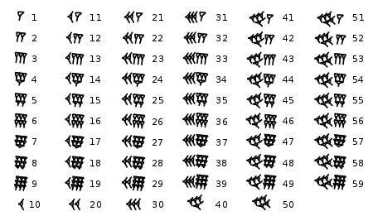
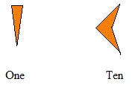
Babylonians used base 60 to count.
The babylonian num
-ber system uses the
symbols.

Slide 4
Problems
this is 18-10
- =
108+45
3x3x2

